Slide 1
Discrete Structures
CS-1005
GCR: e2d2awt
Lecture -3
by
Dr. Fehmida Usmani

Slide 2
Algebraic Proofs of Set Identities
Once a certain number of identities and other properties have been established, new properties can be derived from them algebraically.
To use known properties to derive new ones, you need to use the fact that such properties are universal statements. Like the laws of algebra for real numbers, they apply to a wide variety of different situations.

Slide 3
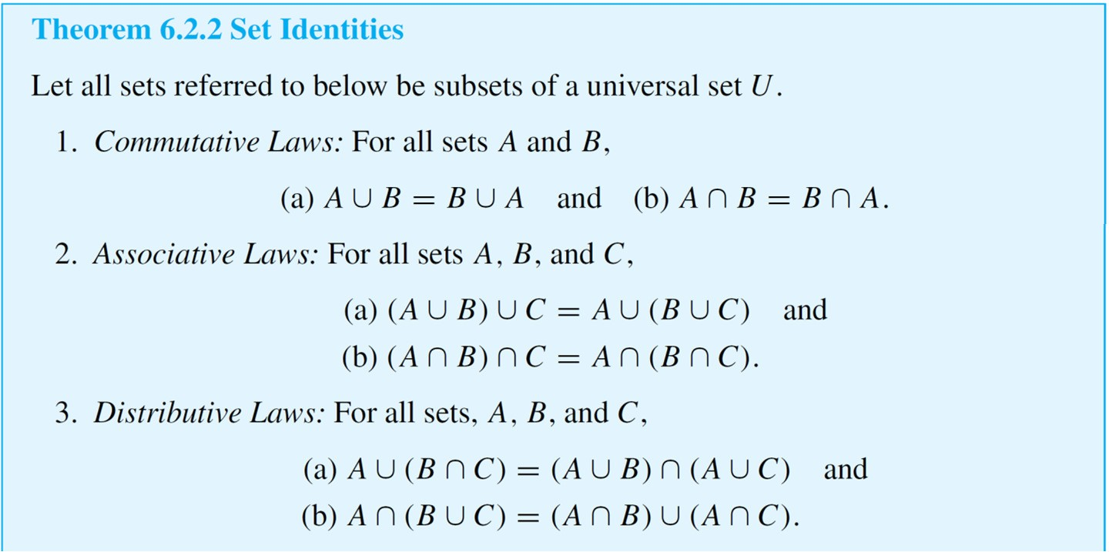
Algebraic Proofs of Set Identities

Slide 4
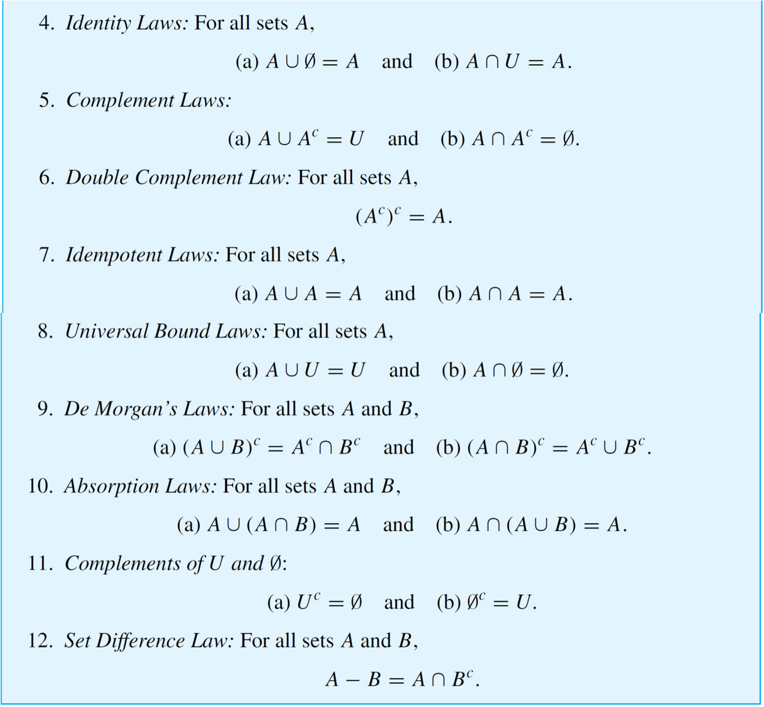
Algebraic Proofs of Set Identities

Slide 5
Algebraic Proofs of Set Identities
Example: Construct an algebraic proof that for all sets A and B,
Cite a property from Theorem 6.2.2 for every step of the proof.
Solution:
Suppose A and B are any sets. Then

Slide 6
Algebraic Proofs of Set Identities

Slide 7
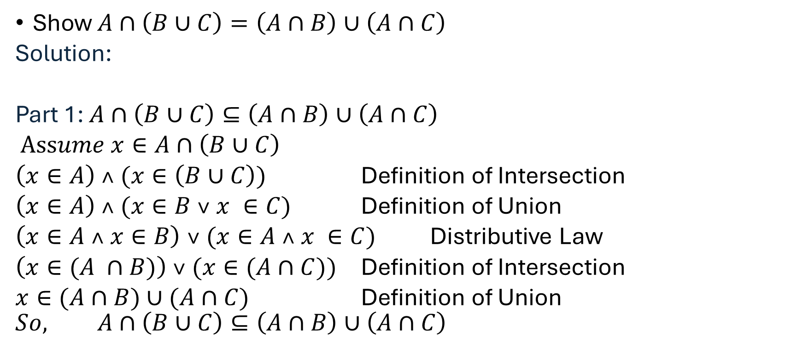
Algebraic Proofs of Set Identities
Show $A∩\left(B∪C\right)=\left(A∩B\right)∪\left(A∩C\right)$
Solution:
Part 1: $A∩\left(B∪C\right)⊆\left(A∩B\right)∪\left(A∩C\right)$
$Assume x∈A∩\left(B∪C\right)$
$\left(x∈A\right) ˄ (x∈\left(B∪C\right))$ Definition of Intersection
$\left(x∈A\right) ˄ (x∈B ˅ x ∈C)$ Definition of Union
$\left(x∈A ˄ x∈B\right) ˅ (x∈A ˄ x ∈C)$ Distributive Law
$\left(x∈(A ∩B)\right) ˅ (x∈(A∩C))$ Definition of Intersection
$x∈(A∩B)∪(A∩C)$ Definition of Union
$$So, A∩\left(B∪C\right)⊆\left(A∩B\right)∪\left(A∩C\right)$$

Slide 8
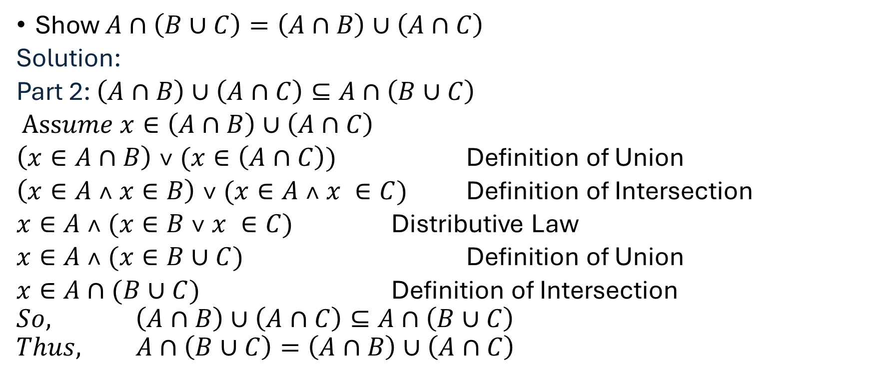
Algebraic Proofs of Set Identities
Show $A∩\left(B∪C\right)=\left(A∩B\right)∪\left(A∩C\right)$
Solution:
Part 2: $\left(A∩B\right)∪\left(A∩C\right)⊆A∩\left(B∪C\right)$
$Assume x∈\left(A∩B\right)∪\left(A∩C\right)$
$\left(x∈A∩B\right) ˅ (x∈\left(A∩C\right))$ Definition of Union
$\left(x∈A ˄ x∈B\right) ˅ (x∈A ˄ x ∈C)$ Definition of Intersection
$x∈A ˄ (x∈B ˅ x ∈C)$ Distributive Law
$x∈A ˄ (x∈B∪C)$ Definition of Union
$x∈A∩(B∪C)$ Definition of Intersection
$$So, \left(A∩B\right)∪\left(A∩C\right)⊆A∩\left(B∪C\right)$$
$$Thus, A∩\left(B∪C\right)=\left(A∩B\right)∪\left(A∩C\right)$$

Slide 9
Algebraic Proofs of Set Identities
Show that (A ∩ B)′ = A′ ∪ B′
Show that A ∩ (A ∪ B) =A
Show that A ∪ (B ∩ A′) = (A ∪ B) ∩ (A ∪ A′)
Show that A ∩ (B ∪ A′)=A ∩ B

Slide 10
Functions
In discrete mathematics, a function is defined as a relation between two sets, typically called the domain and the codomain, where each element in the domain is associated with exactly one element in the codomain.
For example, suppose that each student in a discrete mathematics class is assigned a letter grade from the set {A,B,C,D, F}.
Ali
Babar
Umer
Imran
Hamza
A
B
C
D
F

Slide 11
Functions
In the context of discrete mathematics, functions have several key applications in computer science:
Hash Functions: Hash functions map large data inputs to smaller, fixed-size outputs, commonly used in data structures like hash tables for efficient data retrieval.
Cryptography: Functions are essential in cryptographic algorithms, where they map input data to encrypted outputs, ensuring data security and integrity.
Graph Theory: Functions are used to describe relationships between nodes and edges in graphs, which is crucial in network analysis, shortest path algorithms, and connectivity problems.
Algorithms and Complexity: Functions help define the time and space complexity of algorithms, mapping the size of the input to the number of operations or memory required.
Formal Verification: Functions in discrete mathematics are used to model and verify the correctness of software and hardware systems, ensuring that they behave as expected.
Combinatorics: Functions are employed to count and enumerate combinations, permutations, and other discrete structures, which is important in optimization problems and probabilistic analysis.

Slide 12
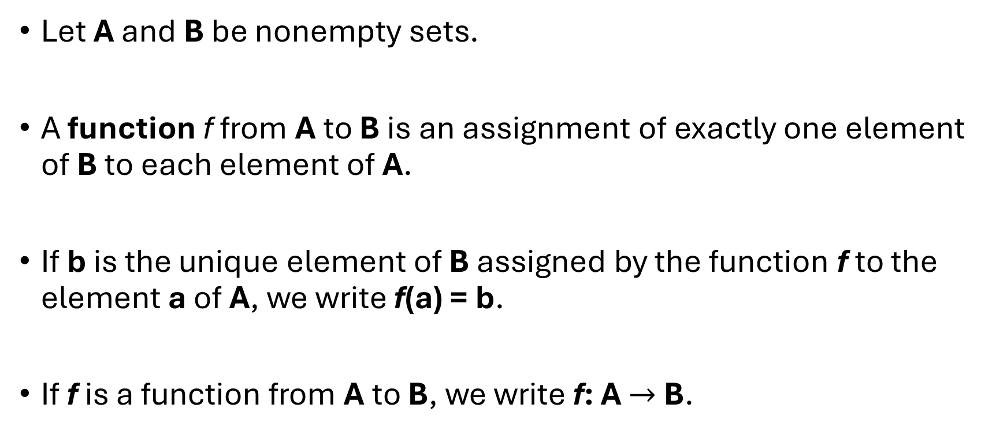
Functions
Let A and B be nonempty sets.
A function f from A to B is an assignment of exactly one element of B to each element of A.
If b is the unique element of B assigned by the function f to the element a of A, we write f(a) = b.
If f is a function from A to B, we write f: A $→$ B.

Slide 13
Functions
If f is a function from A to B, we say that A is the domain of f and B is the codomain of f.
if f(a) = b, we say that b is the image of a and a is the pre-image of b.
The range of f is the set of all images of elements of A.
Also, if f is function from A to B, we say that f maps A to B.

Slide 14
Functions
The definition of a function implies that the arrow diagram for a function f has the following two properties:
Every element of A has an arrow coming out of it
No elements of A has two arrows coming out of it that point to two different elements of B.

Slide 15
Functions
The pre-image
of 1
The image
of “a”
Domain
Co-domain
Ali
Babar
Chishti
Dawood
Ammara
A
B
C
D
F
“a”
“bb“
“cccc”
“dd”
“e”
1
2
3
4
5
A class grade function
A string length function
g(Ali) = A
g(Babar) = C
g(Chishti) = A
…
f(x) = length x
f(“a”) = 1
f(“bb”) = 2
…

Slide 16
Functions
The range of f is the set of all images of elements of A.
Range
a
e
i
o
u
1
2
3
4
5

Slide 17
Functions
“a”
“bb“
“cccc”
“dd”
“e”
1
2
3
4
5
Not a valid function

Slide 18
Functions
Which of the arrow diagrams define functions from
A = {2,4,5,6,7} to B = {1,2,4,6,8}.
Which of the arrow diagrams define functions from
A = {2,4,5,6,7} to B = {1,2,4,6,8}.
Domain
Co-domain
Domain
Co-domain
2
4
5
6
7
1
2
4
6
8
2
4
5
6
7
1
2
4
6
8
Not a Function
Not a Function

Slide 19
Functions
One to one Function
A function is one-to-one if each element in the co-domain has a unique pre-image
Formal definition: A function f is one-to-one if f(a) = f(b) implies a = b for all a and b in the domain of f.
a
e
i
o
1
2
3
4
5
a
e
i
o
1
2
3
4
5
A one-to-one function
A function that is
not one-to-one

Slide 20
Functions
Injective is synonymous with one-to-one
“A function is injective”
A function is an injection if it is one-to-one
Note that there can be un-used elements in the co-domain
a
e
i
o
1
2
3
4
5
A one-to-one function

Slide 21
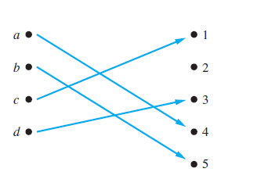

Functions
Determine whether the function $f$ from $\{a, b, c, d\}$to $\{1, 2, 3, 4, 5\}$ with $f\left(a\right)=4, f\left(b\right)=5, f\left(c\right)=1, and$
$f(d)=3$is one-to-one.

Slide 22
Functions
Onto Function
A function is onto if each element in the co-domain is an image of some pre-image
Formal definition: A function f is onto if for all b ∈ B, there exists a ∈ A such that f(a) = b.
a
e
i
o
u
1
2
3
4
a
e
i
o
1
2
3
4
5
An onto function
A function that is not onto

Slide 23
Functions
Surjective is synonymous with onto
“A function is surjective”
A function is a surjection if it is onto
Note that there can be multiple used elements in the co-domain
a
e
i
o
u
1
2
3
4
An onto function

Slide 24
Functions
Are the following functions onto, one-to-one, both, or neither?
a
b
c
1
2
3
4
a
b
c
d
1
2
3
4
a
b
c
1
2
3
4
1-to-1, not onto
Both 1-to-1 and onto
Not a valid function
a
b
c
d
1
2
3
a
b
c
d
1
2
3
4
Onto, not 1-to-1
Neither 1-to-1 nor onto

